Slide 1


MOVIE RECOMMENDATION SYSTEM
SAMUEL KARU: GROUP 5
NAMES: Blex Olonde, Dennis Muriungi, Jasho Kiplangat, Shem Omondi and Valary Kones

Slide 2

Business Problem
Users struggle to discover relevant movies
Large catalogs cause choice overload
Sparse feedback limits personalization
Need accurate, scalable recommendation.

Slide 3

Dataset Overview
100,836 ratings
610 users
9,742 movies
98.3% sparse interaction matrix

Slide 4
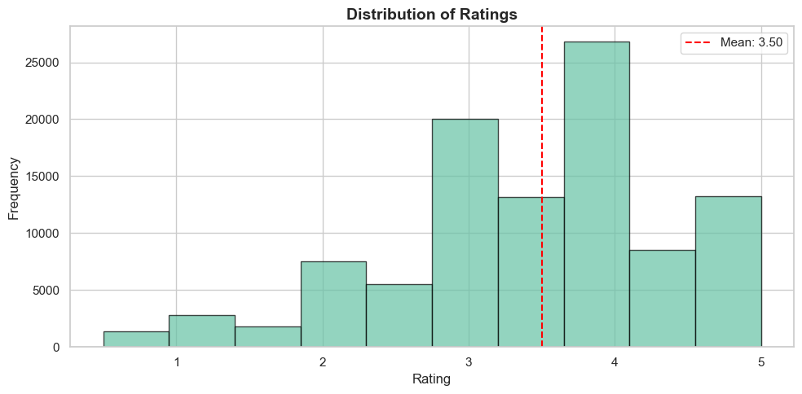
Exploratory Insights (Movie Popularity)
Ratings range from 0.5 to 5.0
Mean rating = 3.50
Majority of ratings fall between 3.0–4.0
Very few ratings below 2.0

Slide 5
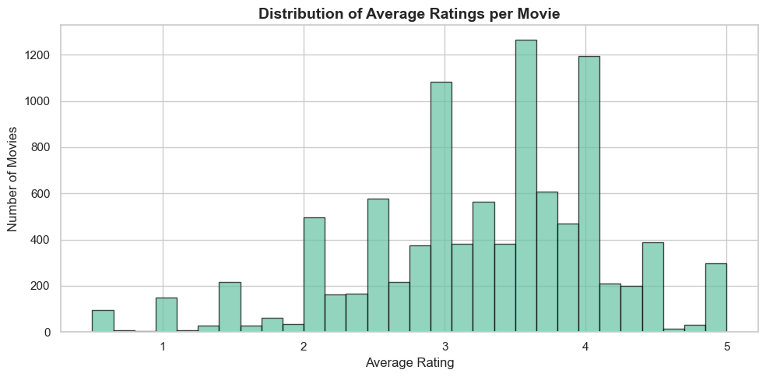
Movie Popularity
7,000+ movies have fewer than 10 ratings
Only a small number exceed 50 ratings
Average ratings per movie = 10.4
Strong long-tail distribution

Slide 6

Baseline: KNNBasic
Improved KNNWithMeans (user & item)
Matrix factorization: NMF and SVD
GridSearch used for tuning
Modeling Approach

Slide 7
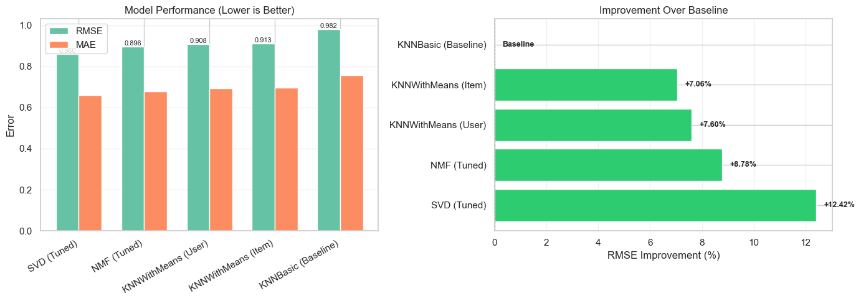
Model Performance
Baseline RMSE: 0.982
Best RMSE (SVD): 0.860
12.4% improvement over baseline
SVD selected as final model

Slide 8
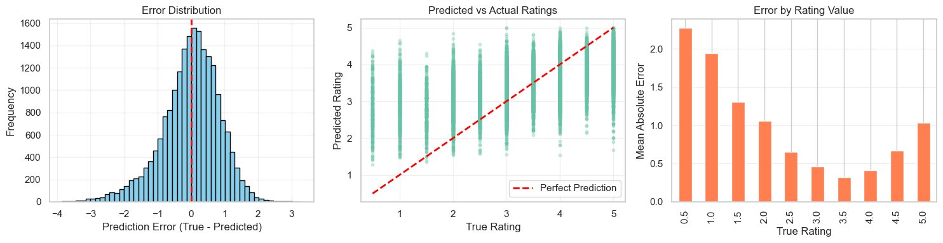
Error Analysis (SVD)
Mean error ≈ –0.016 (unbiased)
Errors mostly within ±1 rating
Strong at mid-range ratings
Weak at extreme ratings

Slide 9
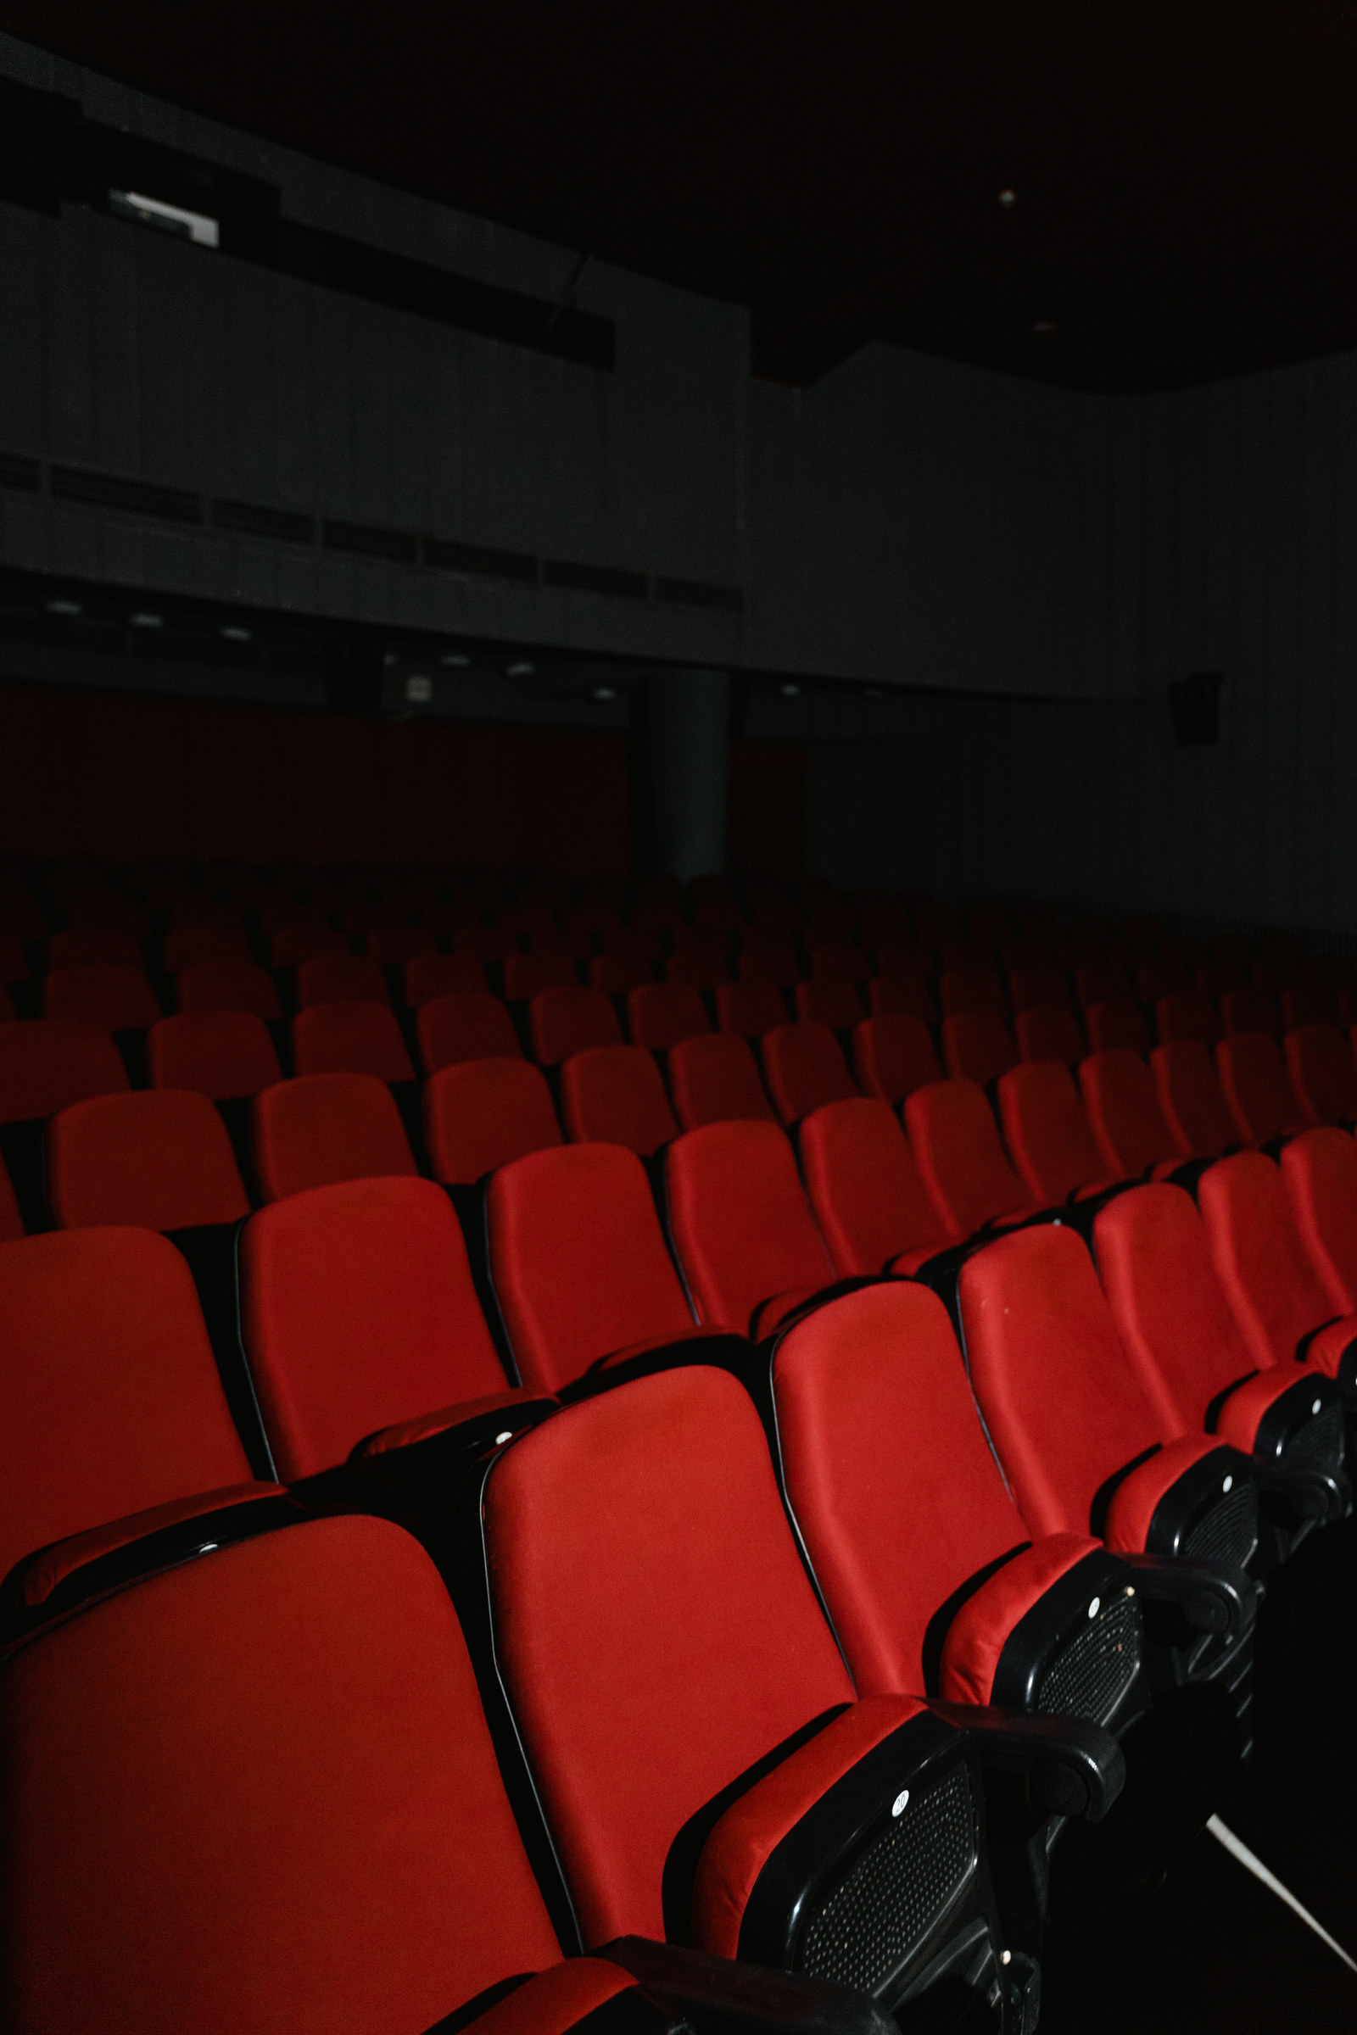
Recommendation Output
Estimates user preferences for all unseen movies
Prioritizes titles with the highest predicted ratings
Delivers a personalized Top-5 movie list
Avoids recommending previously rated content

Slide 10

THANK
YOU

